Slide 1
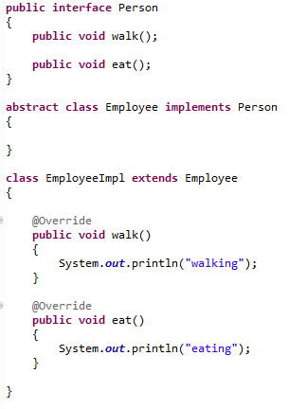
When an Abstract Class Implements an Interface
It was noted that a class that implements an interface must implement all of the interface's methods. It is possible, however, to define a class that does not implement all of the interface's methods, provided that the class is declared to be abstract.

